Slide 1
ARDUINO
UNO
IR Sensor 1
Servo Motor
IR Sensor 2
IR Sensor 3
LEDs
9V Battery

Slide 2
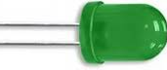
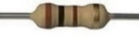
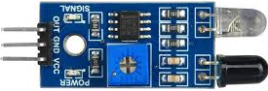
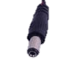
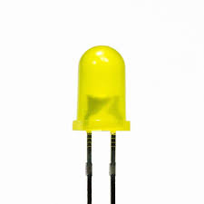
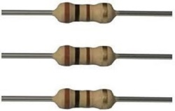
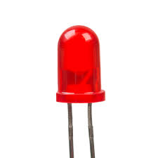
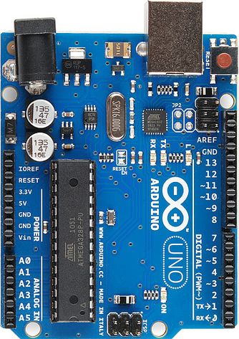


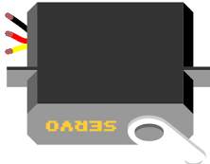
Slot_1
Slot_2
Battery Plug
Gate_grn
IR Sensor 1 Slot 1
Gate_red
Power Switch
IR Sensor 2 Slot 2
Arduino UNO
Power LED
IR Sensor 3 Gate Sensor
9V Battery
Gate Servo

